Slide 1

Site Suitability for Solar Power Plant in Saskatchewan province
GGE 3423-Introduction to GIS
Term Project
Group members:
Vasuki Sai Prabhath Lolla #3664859
Sarath Chandra Veeturi #3667179

Slide 2
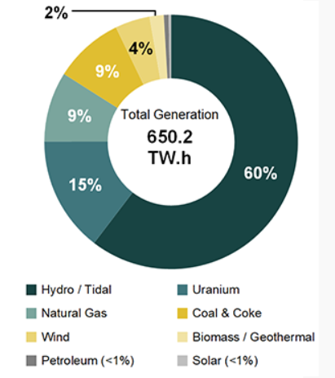
Usage of different energy sources for power generation in Canada
Source @Statistics Canada (Tables 25-10-0020-01 and 25-10-0019-01), NEB Estimates

Slide 3
Problem statement:
Most than half of the power generated in Canada is through hydro sources
Even though many regions of southern Canada have a good scope for adapting solar power <1% of the power is generated through solar sources.
If the government of Canada decides on using solar energy as a source of electricity, which areas are most suitable for establishing a Solar farm?

Slide 4
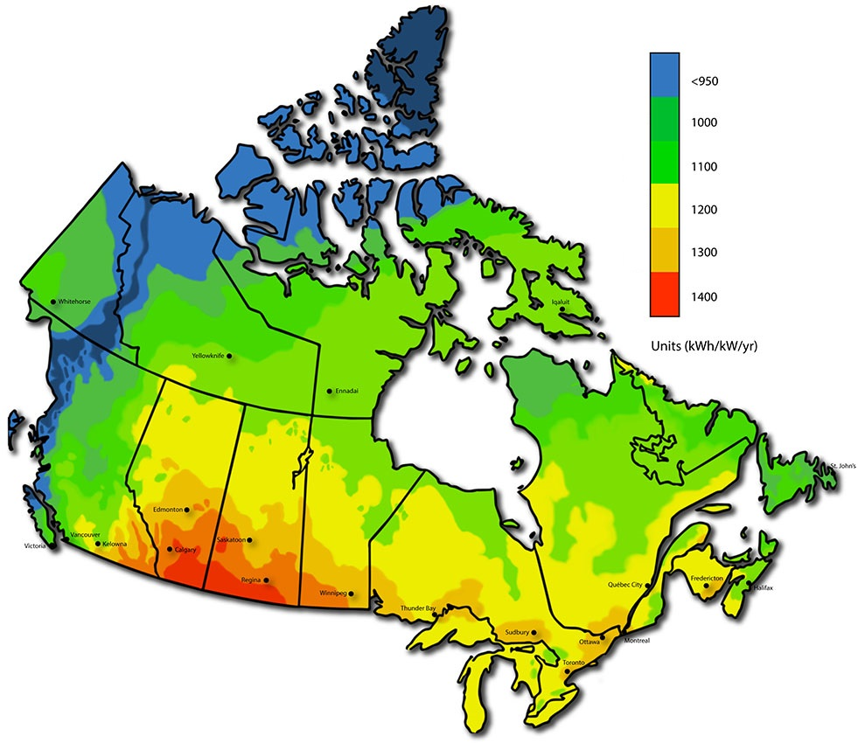
Map of Canada showing the solar power capacity
Image source @Energyhub.org

Slide 5
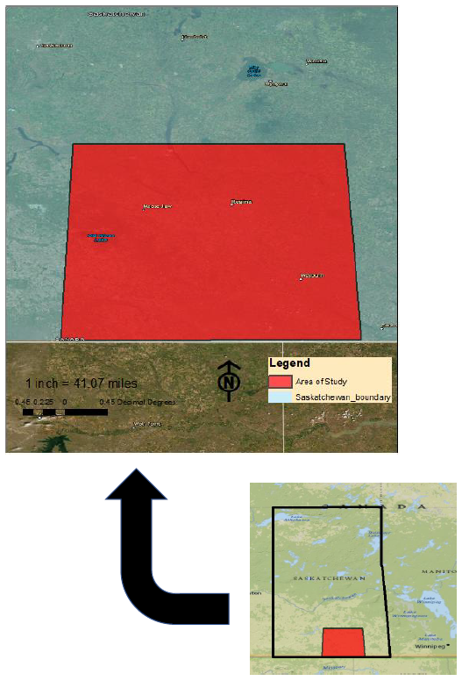
Study area

Slide 6
Basic geographic requirements for a solar farm:
A typical solar power plant requires minimum of 15 hectares(0.15 sq kms) of land with around 30% of the entire area being covered by up to 20,000 solar panels (Scott Mackey et al, 2017)
Area of study occupies 50,505 Sq Kms in UTM Zone 13N NAD83 projection
Several other factors like solar radiation, distance from roads, distance from power lines, slope, land use etc are considered in this study to obtain suitability site for solar farm

Slide 7
Factors considered for site selection for Solar farm:
1.Non-modifiable variables *Residential areas *Water bodies *Wetlands *Roads 2.Weighted variables *Solar radiation *Slope *Land use *Distance from electric power lines *Distance from roads
Sources of datasets: Canada’s Ministry of Natural Resource’s Geogratis Geospatial Data Extraction tool (https://www.nrcan.gc.ca/science-and-data/science-and-research/earth-sciences/geography/topographic-information/download-directory-documentation/17215), MapCruzin.com for Saskatchewan (https://mapcruzin.com/free-canada-saskatchewan-arcgis-maps-shapefiles.htm)

Slide 8
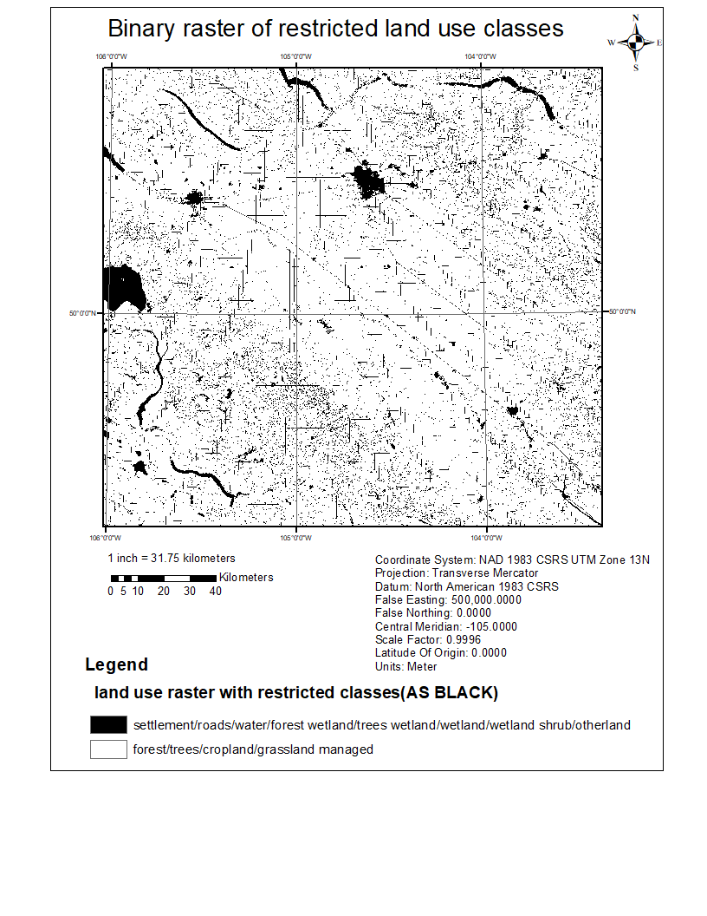
Map of Non-modifiable variables:
The map represents the areas in Saskatchewan that must be restricted and should not be considered for establishing a solar farm
The map is a binary raster map with raster cell values of 0(black) and 1(white)
The raster cells with a 0-raster value(black) are restricted areas and the raster cells with 1 (white) raster values can be used for a solar farm

Slide 9
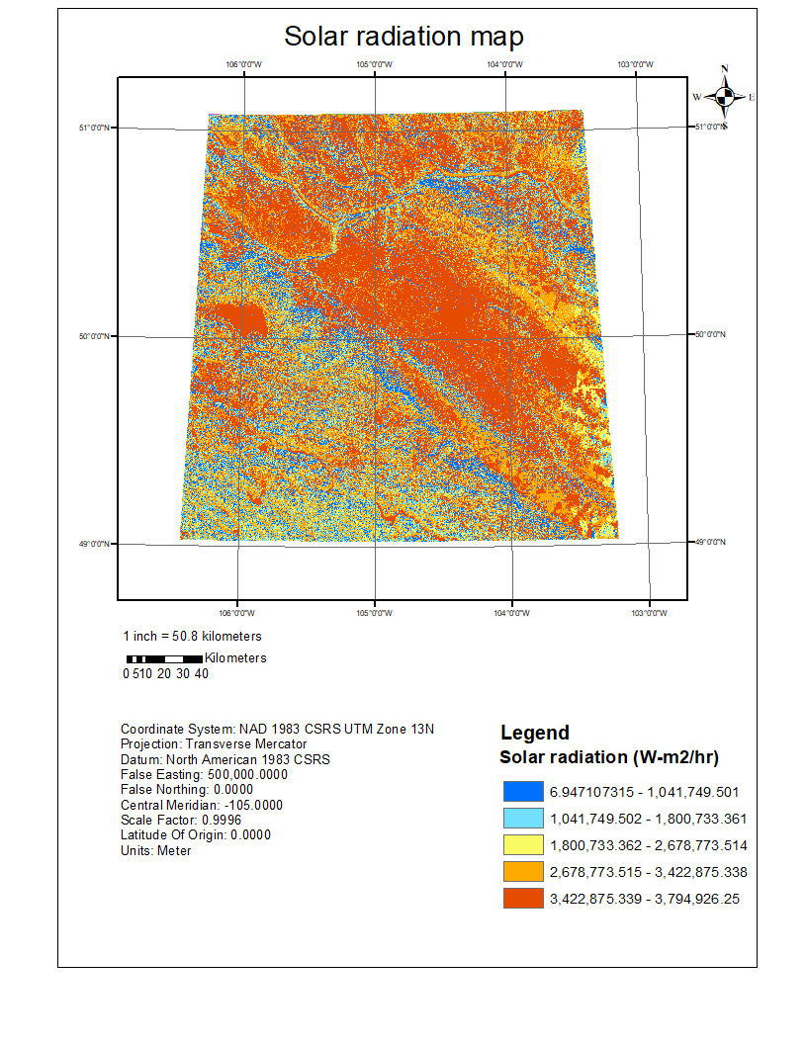
Maps of weighted variables:
i ) Solar Radiation map
Solar radiation map generated from AREA SOLAR RADIATION tool in Arc Toolbox for the year 2018
Inputs- *digital surface model with a spatial resolution of 0.75 arc/second
Outputs-
*Solar radiation map with WH/Sq mts units

Slide 10
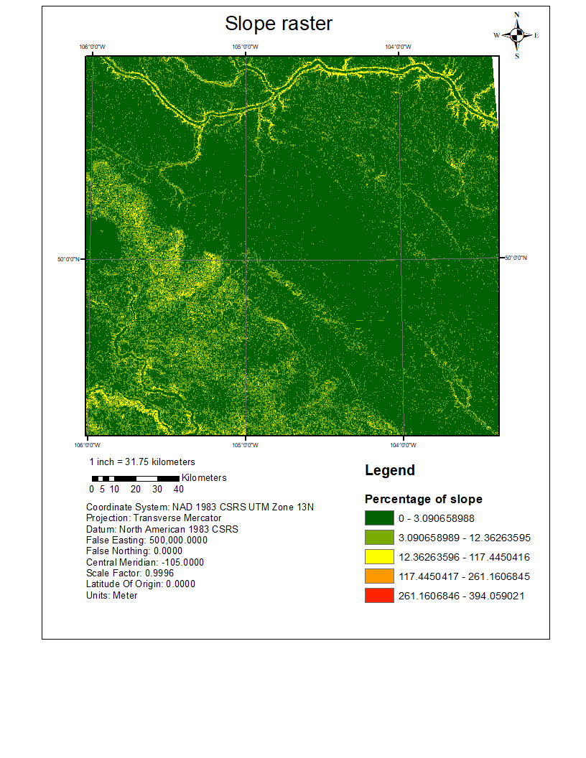
Maps of weighted variables:
ii) Slope raster map
The lower slope value indicates that the area is mostly suitable for solar farms regarding terrain being flat.
Most of the studies on Solar farm site suitability mapping, have considered that the ideal slope is less than 3-5%.

Slide 11
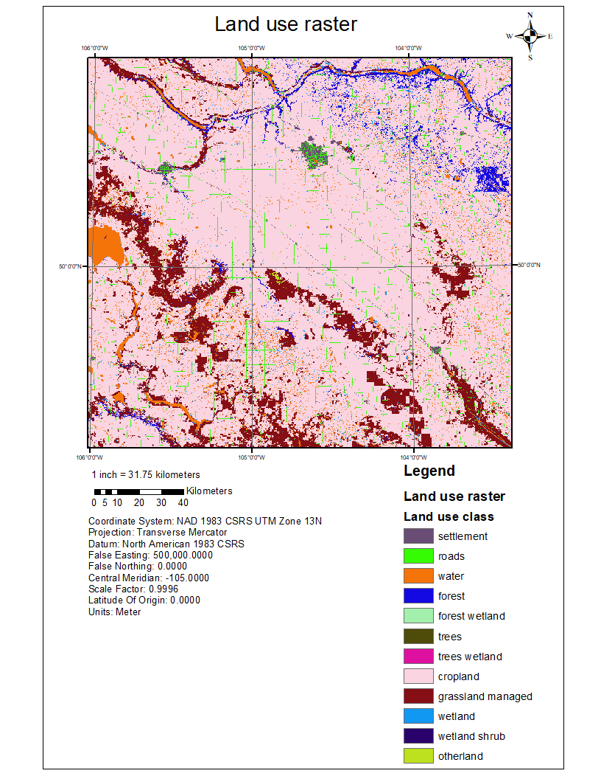
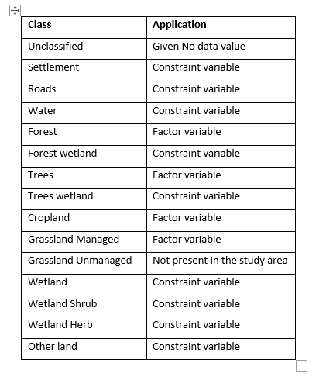
Maps of weighted variables:
iii) Land use map

Slide 12
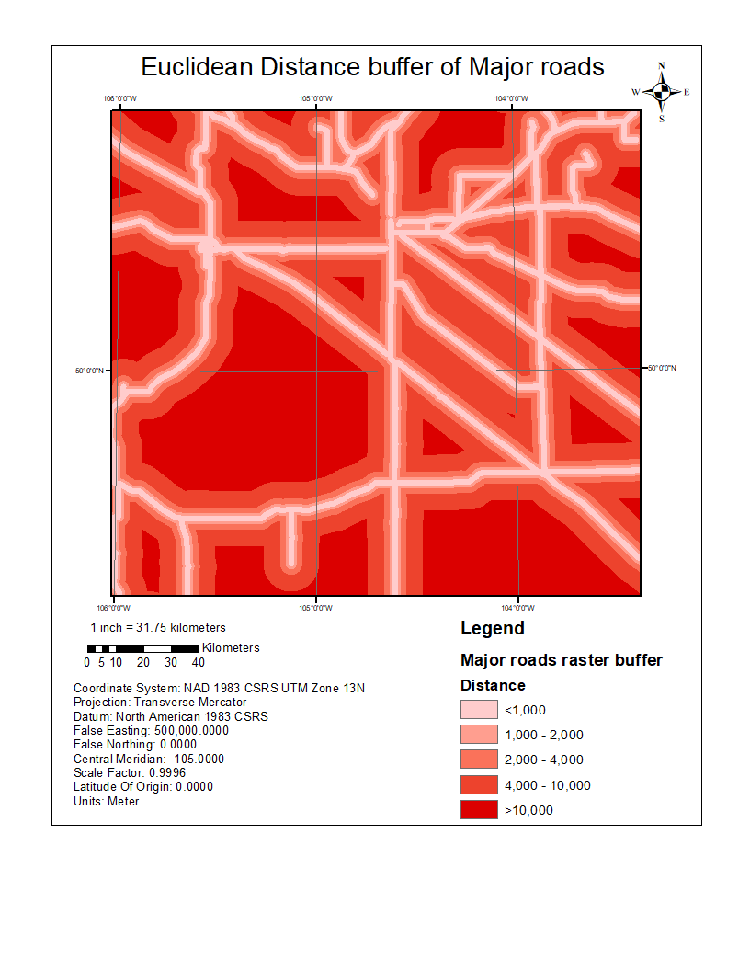
Maps of weighted variables:
iv) Road network raster buffer
A raster buffer of the road network raster with a cell size of 30 meters is created
The primary roads and trunk roads are considered for the buffer
Based on distances from the considered road the suitability site for solar farm has been mapped
This factor is considered to reduce the time taken to carry the required material for construction of solar farm.

Slide 13
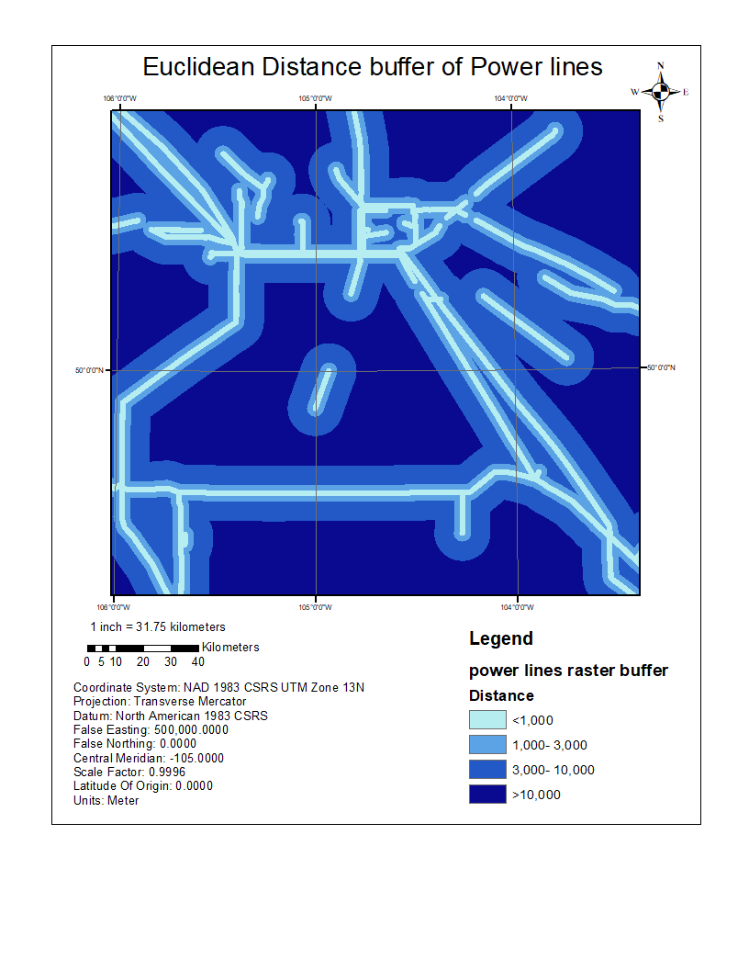
Maps of weighted variables:
v) Power line raster buffer
The power line raster with a cell size of 30mts is created
A buffer to the existing power lines grid is generated and is divided into four classes depending upon the distances
This factor is considered to eliminate construction of new power line grid to transmit the generated electricity

Slide 14
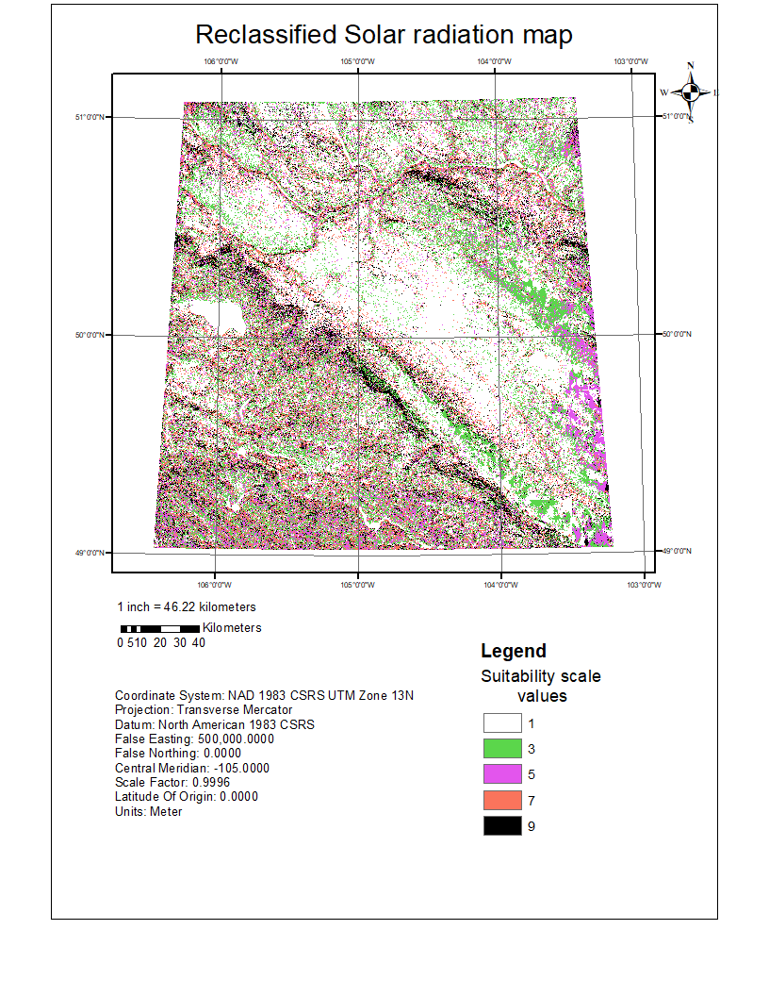
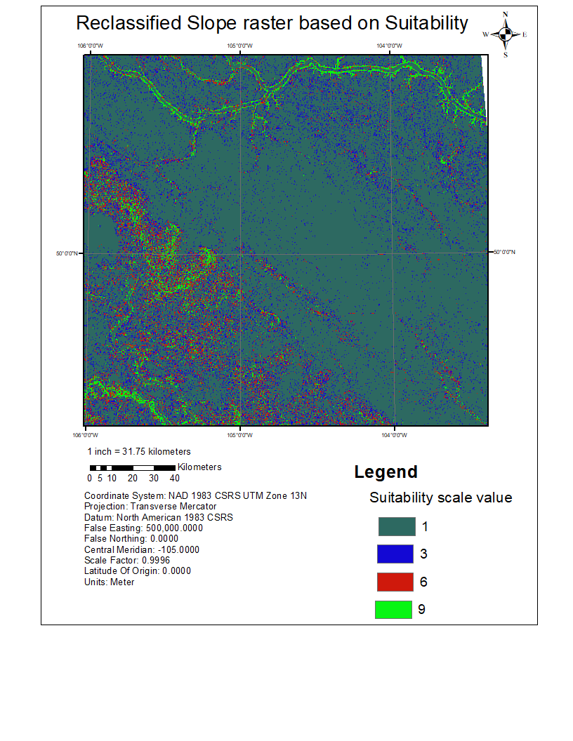
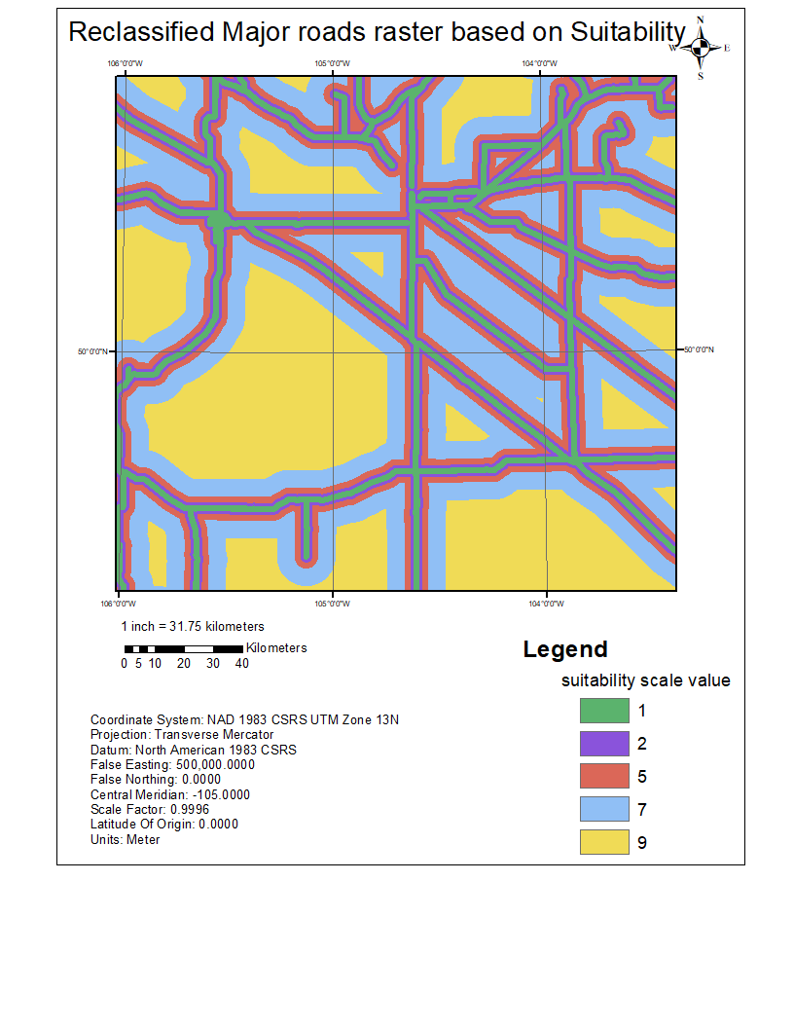
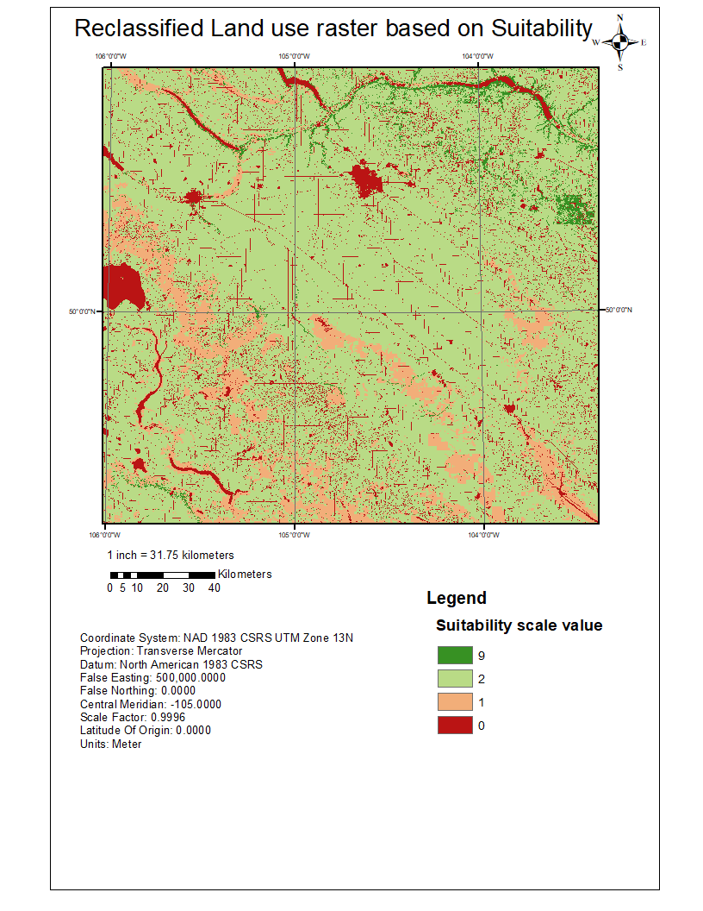
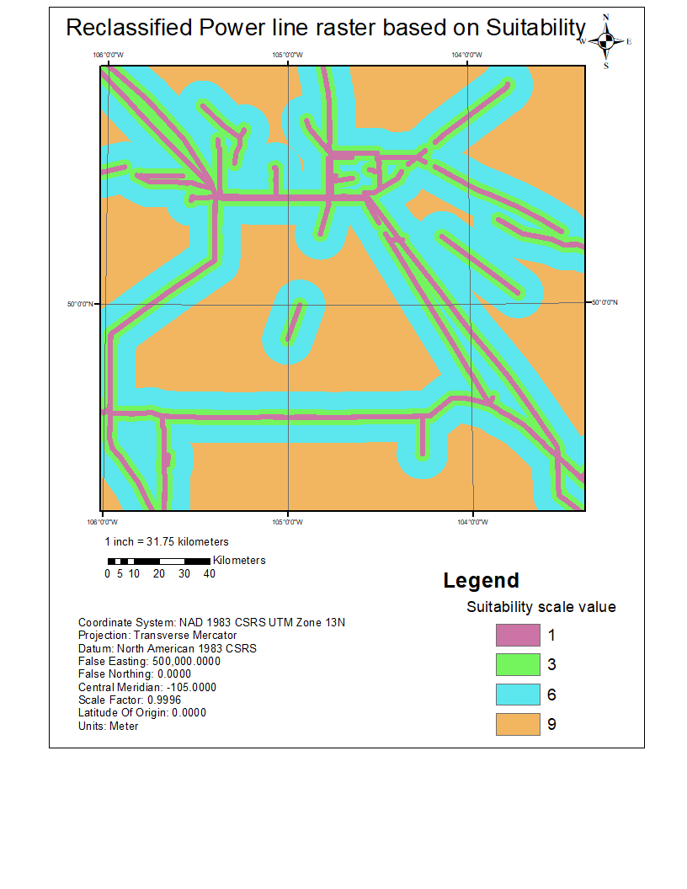
Reclassification of weighted variable
The variables are reclassified to bring the different factors or items in the legends into a single unit so that they can be compared
These reclassified variables are used in the analytical hierarchal process algorithm to obtain weightages on a common scale

Slide 15
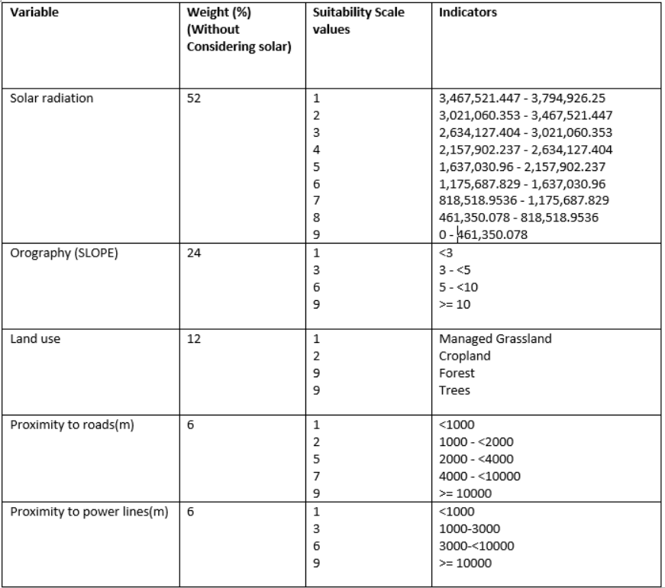
Reclassification values for different variables:

Slide 16
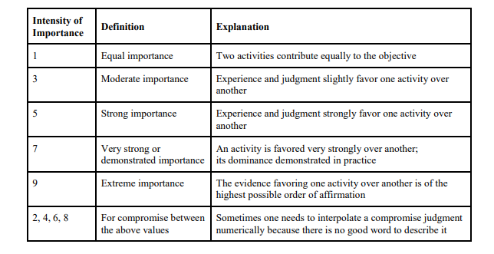
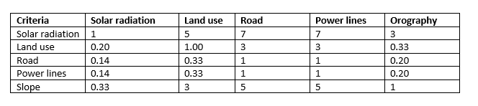
Pairwise comparison matrix for obtaining weights:
The table represents the definition of each integer value given in the pair wise comparison matrix
The matrix values are considered based on Scott Mackey’s study on the solar site selection in Ontario

Slide 17
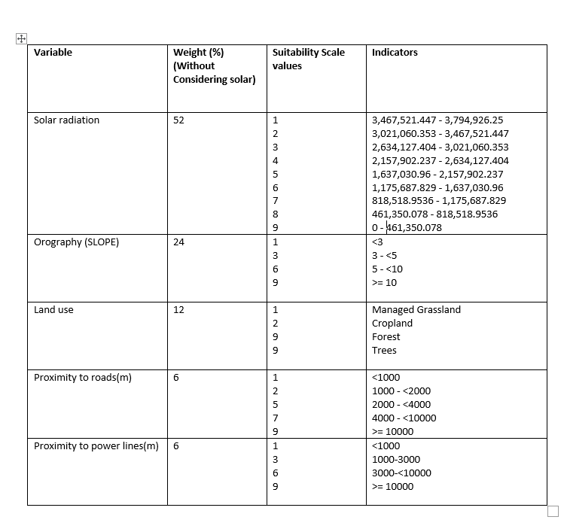
Obtained weightages for different class of variables after AHP:

Slide 18
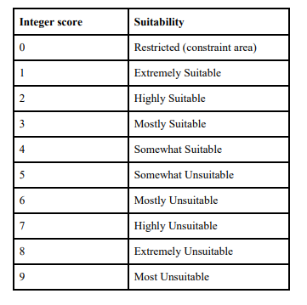
Weighted overlay analysis:
The weights obtained from the analytical hierarchal process are used as input for weighted overlay analysis
Based on the weights of the variables the weighted overlay analysis produced an output with integer values which represent the suitability for a solar farm
In this study the output contained four classes after considering the non-modifiable variables and the weighted variables

Slide 19
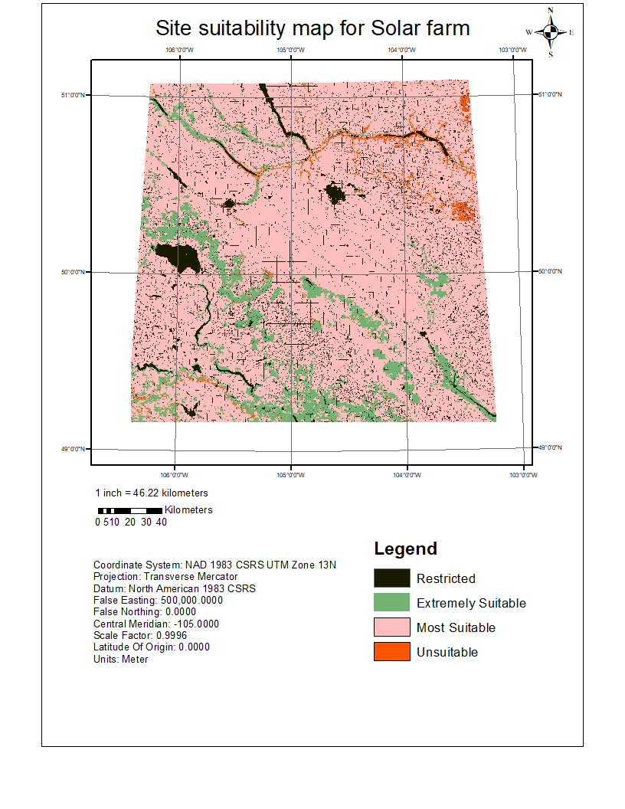
Solar site suitability map:

Slide 20

Scalability and future scope:
The construction of solar farm might take a lot of time and man power. So, the idea of solar farms can be minimised and brought down into rooftop solar panels.
Rooftop solar panels are much effective because it does not require many geographic variables to be considered on a rooftop.
Each rooftop solar panel can be used to generate and supply power to the corresponding building on which the solar panel is present on.

Slide 21
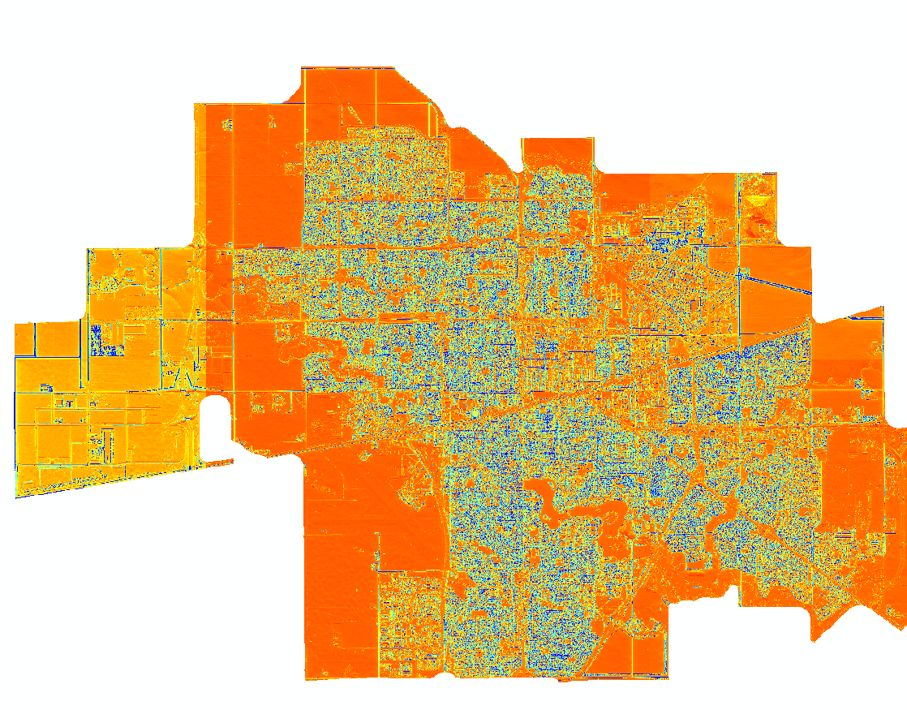
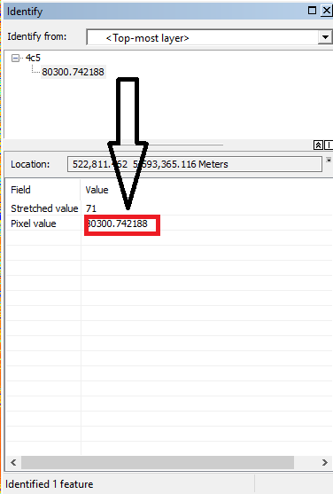
Area Solar map of Regina city
Value of solar power generated from a rooftop solar panel on a building
The pixel value is in WH/sq mt units.

Slide 22
Thank you for listening…..
Questions…?
https://sarathveeturi.github.io/SolarpowerplantSite/

Slide 23
